Slide 1
BB Predict
Kurt Weinheimer

Slide 2
Week 0: BB Model vs. UMBC Model
Metric | BB Model | UMBC Model
Precision | 0.61 | 0.61
Recall | 0.33 | 0.36
F1 Score | 0.43 | 0.45
ROC AUC | 0.79 | 0.82

Slide 3
Week 3: BB Model vs. UMBC Model
Metric | BB Model | UMBC Model
Precision | 0.67 | 0.82
Recall | 0.39 | 0.36
F1 Score | 0.49 | 0.50
ROC AUC | 0.83 | 0.82

Slide 4
Week Progression - Metrics
BB Model:
Metric | Week 0 | Week 3 | Week 6 | Week 9 | Week 12
Precision | 0.61 | 0.67 | 0.73 | 0.76 | 0.75
Recall | 0.33 | 0.39 | 0.50 | 0.62 | 0.67
UMBC Model:
Metric | Week 0 | Week 3 | Week 6 | Week 9 | Week 12
Precision | 0.59 | 0.85 | 0.83 | 0.84 | 0.86
Recall | 0.36 | 0.34 | 0.36 | 0.37 | 0.40

Slide 5
Week Progression - 0.4 Cutoff
BB Model:
Metric | Week 0 | Week 3 | Week 6 | Week 9 | Week 12
Precision | 0.61 | 0.67 | 0.73 | 0.76 | 0.75
Recall | 0.33 | 0.39 | 0.50 | 0.62 | 0.67
UMBC Model:
Metric | Week 0 | Week 3 | Week 6 | Week 9 | Week 12
Precision | 0.59 | 0.71 | 0.75 | 0.74 | 0.78
Recall | 0.36 | 0.47 | 0.48 | 0.52 | 0.51

Slide 6
Week Progress - Top 5 Most Important Features
Week 0 | Week 3 | Week 6 | Week 9 | Week 12
CourseSize 0.204903 PrevTermGPA 0.081850 CumulativeGPA 0.075067 CourseLevel 0.059680 CareerCreditCompletionPerc 0.052071 | GradePercentage 0.065324 GradePercentageRank 0.046163 CumulativeGPA 0.045924 PrevTermGPA 0.044415 TotalDurationRank 0.033995 | GradePercentage 0.094726 GradePercentageRank 0.062881 CumulativeGPA 0.040488 PrevTermGPA 0.035156 TotalDurationRank 0.033307 | GradePercentage 0.116055 GradePercentageRank 0.066210 CumulativeGPA 0.040748 TotalDurationRank 0.035396 PrevTermGPA 0.034829 | GradePercentage 0.135747 GradePercentageRank 0.053991 CumulativeGPA 0.048526 PrevTermGPA 0.036578 TotalInteractionsRank 0.031060

Slide 7
Week 3 Breakdown by Class Number
Metric | 100-Classes | 100-200 Classes | 100-300 Classes | Not 100 Classes | Not 100-200 Classes | All Classes
Precision | 0.83 | 0.83 | 0.82 | 0.82 | 0.89 | 0.82
Recall | 0.47 | 0.39 | 0.37 | 0.32 | 0.31 | 0.36
F1 Score | 0.60 | 0.53 | 0.51 | 0.46 | 0.46 | 0.50
ROC AUC | 0.87 | 0.86 | 0.86 | 0.86 | 0.84 | 0.85

Slide 8
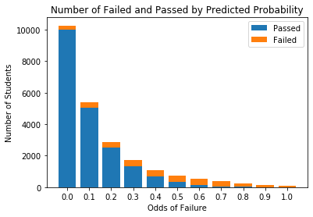
Distribution for Week 3 - All Classes

Slide 9
Cutoff Point, Week 3 All Classes
Metric / Cuttoff (> than x is 1) | 0.3 | 0.4 | 0.5 | 0.6 | 0.7
Precision | 0.60 | 0.71 | 0.82 | 0.90 | 0.96
Recall | 0.59 | 0.47 | 0.36 | 0.25 | 0.15
F1 Score | 0.60 | 0.56 | 0.50 | 0.39 | 0.26

Slide 10
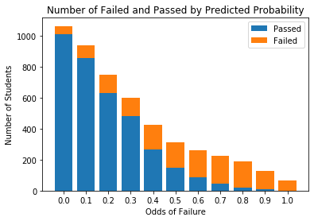
Distribution for Week 3 - Top 100 DFW Classes

Slide 11
Cutoff Point, Week 3 Top 100 DFW Classes
Metric / Cuttoff (> than x is 1) | 0.3 | 0.4 | 0.5 | 0.6 | 0.7
Precision | 0.65 | 0.74 | 0.82 | 0.88 | 0.93
Recall | 0.74 | 0.63 | 0.51 | 0.38 | 0.25
F1 Score | 0.69 | 0.68 | 0.63 | 0.54 | 0.40

